Slide 1
FUNCTIONS

Slide 2
FUNCTIONS
In JavaScript, a function allows you to define a block of code, give it a name and then execute it as many times as you want.
Simply its a block of code designed to perform a particular task.
A JavaScript function is executed when "something" invokes it (calls it).

Slide 3
Function Definition
A JavaScript function can be defined using function keyword.
A JavaScript function is defined with the function keyword, followed by a name, followed by parentheses ().
Function names can contain letters, digits, underscores, and dollar signs (same rules as variables).
The parentheses may include parameter names separated by commas: (parameter1, parameter2, ...)
The code to be executed, by the function, is placed inside curly brackets: {}

Slide 4
Function Syntax
//defining a function
function <function-name>()
{
// code to be executed
};

Slide 5
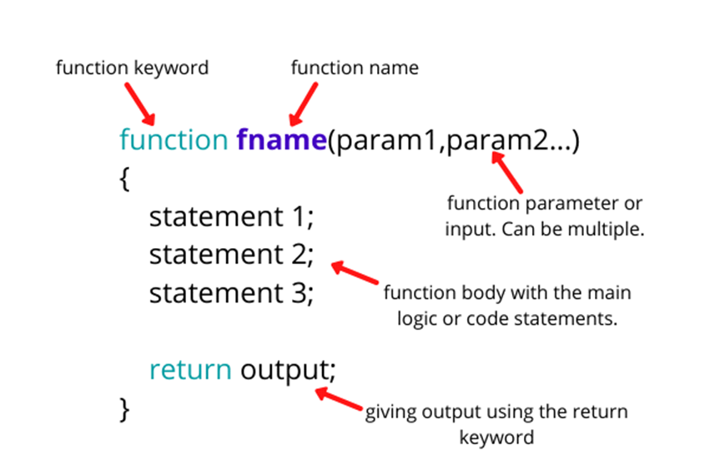

Slide 6
Function Invocation
The code inside the function will execute when "something" invokes (calls) the function:
When an event occurs (when a user clicks a button)
When it is invoked (called) from JavaScript code
Automatically (self invoked)
//calling a function
<function-name>();

Slide 7
Function Return
When JavaScript reaches a return statement, the function will stop executing.
If the function was invoked from a statement, JavaScript will "return" to execute the code after the invoking statement.
Functions often compute a return value. The return value is "returned" back to the "caller":
Eg: function add(n1,n2){
console.log( n1+n2);
}add(5,6);

Slide 8
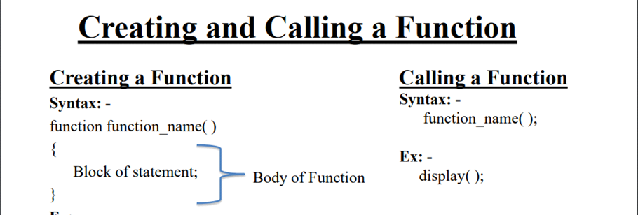

Slide 9
Arrow Functions
An arrow function expression is a compact alternative to a traditional function expression, but is limited and can't be used in all situations.
Every programming language provides certain kinds of practices to write any function. The arrow function syntax is one of the most used and efficient ones to create a function in JavaScript.
How to create arrow function: To write the arrow function, simply create any variable it can be const, let, or var but always do prefer with const to avoid unnecessary problems. And then do assign the function code to the variable that’s it. So from now, you can call that function by writing the parenthesis in front of that variable. With arrow function syntax, we consider function as an object and assign the definition to some variable.

Slide 10
Traditional function V/S Arrow function
// Traditional Function
//SUBTRACTION
function sub(n1,n2){
result=n1-n2;
return result;
}
result=sub(70,50);
console.log(result);
//Using arrow function
var sub=(n1,n2)=>{
result=n1-n2;
return result;
}
result=sub(70,50);
console.log(result);

Slide 11
Types Of Functions
Named function
Anonymous Functions
Recursive Functions

Slide 12
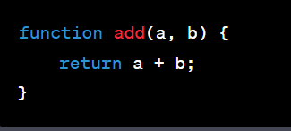
1 Named function
These are functions defined with a name that can be called by that name.
Named functions are useful if we need to call a function many times to pass different values to it or run it several times.

Slide 13
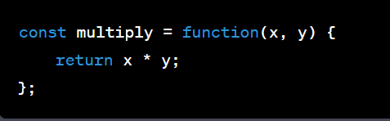
2 Anonymous Functions
These are functions without a name and are often used as arguments to other functions or as immediately invoked function expressions (IIFE).

Slide 14
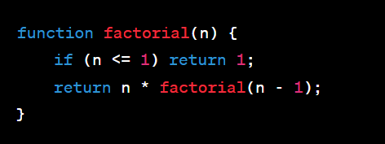
3 Recursive Functions
Functions that call themselves to solve a problem by breaking it down into smaller, similar subproblems.

Slide 15
Tasks
Write a program to find the area of a triangle using function
Write a JavaScript function that accepts a number as a parameter and check the number is prime or not.
Write a JavaScript function that checks whether a passed string is palindrome or not?
Write an anonymous function that takes two numbers as arguments and returns their product.
Create an arrow function that squares a given number.

Slide 16
6 Write a recursive function in JavaScript to calculate the nth Fibonacci number. The Fibonacci sequence is defined as follows: the first two numbers are 0 and 1, and each subsequent number is the sum of the two preceding ones.
7 What is the difference between function parameters and arguments?
8 What is the purpose of the return statement in a function, and what does it do?
9 What are the differences between arrow functions and regular functions in JavaScript?
10 What is the difference between local and global scope in JavaScript functions?

Slide 17
Thank You

